Slide 1
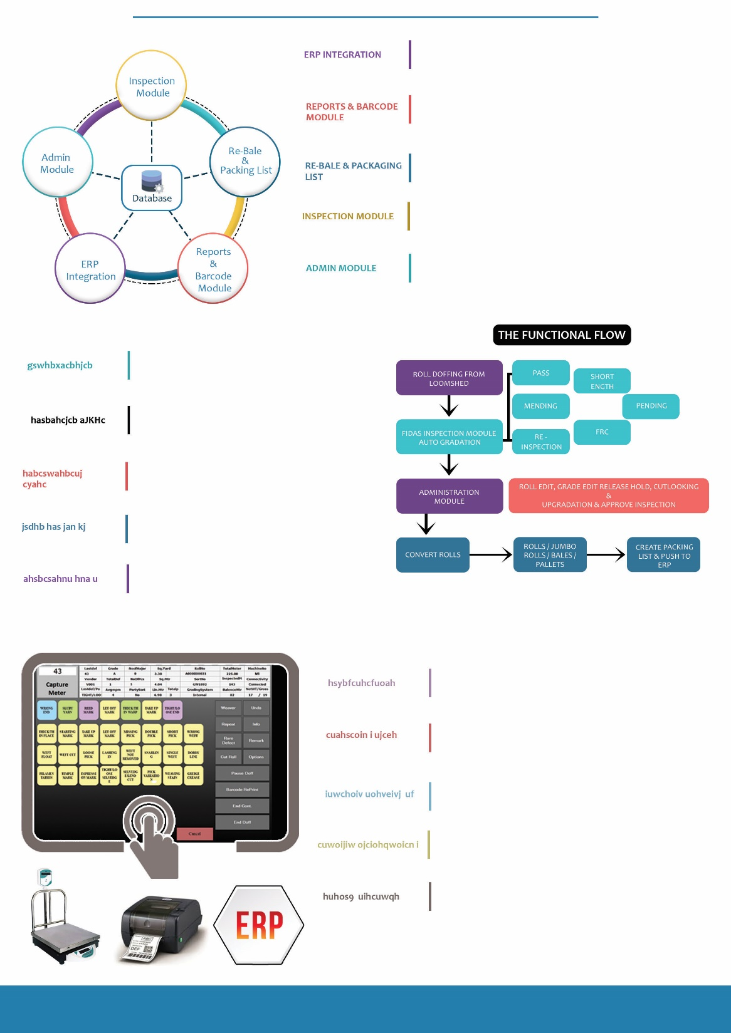
FIDAS automatically acquires roll inform after fabric is doffed from loom with details such as Work Order, Sort, Loom, Declared meter from loom, doff date, Shift etc.
Defect names are shown in Touchscreen with running meter, defects are manually logged by checker and FIDAS calculates Points/100 Sq. Mtrs or linear meters / Sq. yards. FIDAS grades the fabric automatically as per (ASTM 4 POINT SYSTEM). ASTM D5430 standards. Barcode is generated and printed for every roll after inspection.
Inspection Module
To match quality needs of your customers, cut looking / upgradation can be conducted by supervisors after inspection is completed. Inspected fabric can be sent to buyers as Rolls, Bales, Pallets or Jumbo Rolls as per order requirements and packing list is created and sent to ERP.
Administration Module
To match quality needs of customers, cut looking / upgradation can be conducted by supervisors after inspection is completed. Inspected fabric can be sent to buyers as Rolls, Bales, Pallets or Jumbo Rolls as per order requirements. Can be aggregated base on Sort number and packing list is created against Work Order Number.
We provide greater importance to reporting and we customize reports to suit your exact business needs. All our Reports are generally into Production Reporting, WiP Stock Reporting, Quality Analysis & Reporting, Management Reporting and Reconciliation
Reports Module

Slide 2
Display running meter using RS-232 from electronic length counter
Interactive sound response while logging defects
No keyboard or mouse interface
Easy to use by any un-educated or computer illiterate checker
Easy to deploy at any make or model of inspection machine
Displays real-time points/100 Square meters or linear meters
EPI / PPI / Width measurement options
Weaver wise / Loom wise defect analysis / loom Shed Alert
Displays pending meters of inspection
Double panel inspection option
Department wise defect colouring display Option
Inspector wise productivity Monitoring
Order Wise / Sort Wise realization
Option to Cut / Merge / or push to upgradation option
Options to enter continuous defects and categorize as non-serious
View roll information any-time during inspection
View Real-time grades during inspection as per ASTM 4 Point System
Record Inspection duration, mending time and count mendable defects
Automatic integration with Weighing Scale
Automatic gradation of Fabric based on length and demerit points
Barcode and QR Code Printing at end of every roll
Alert in case of GSM variation

Slide 3
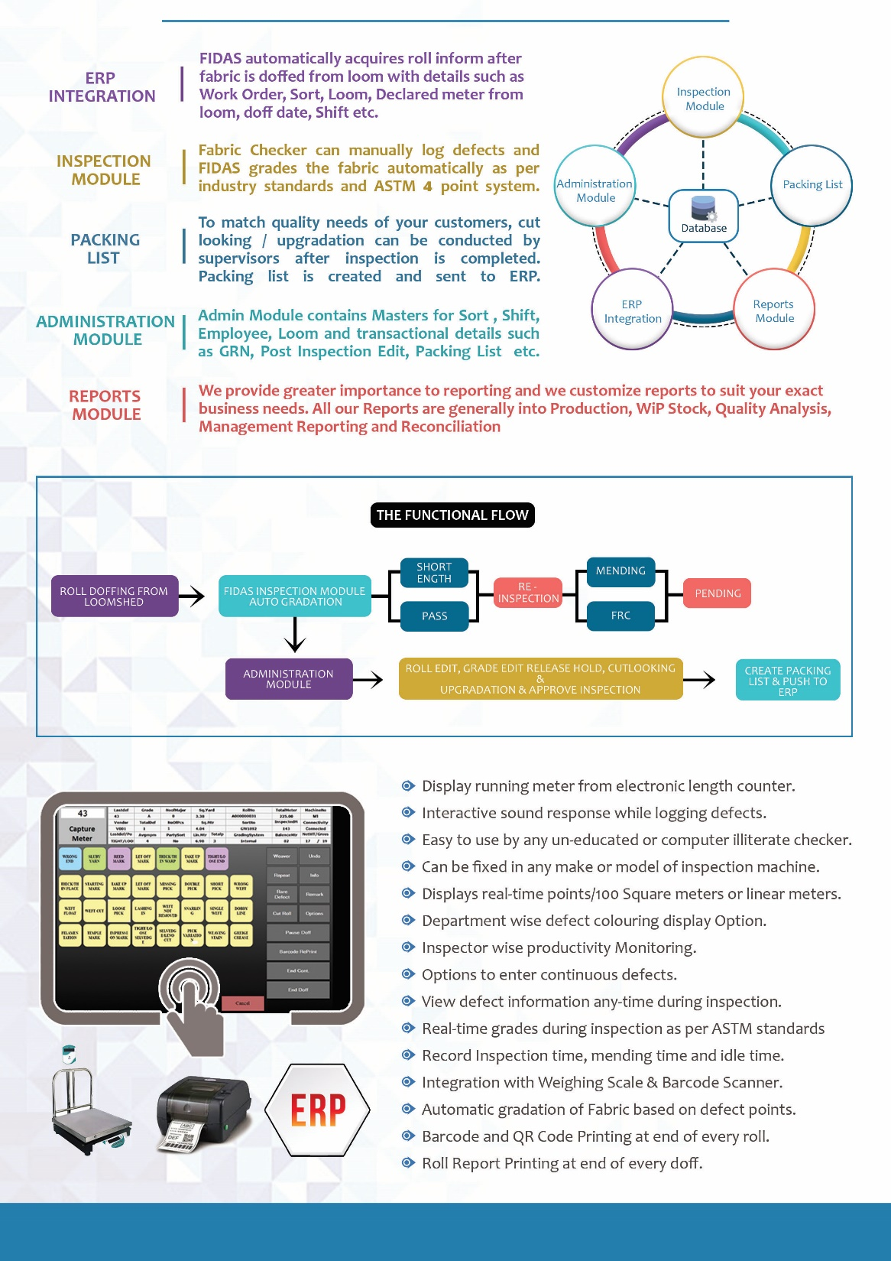
FIDAS – Greige Fabric Inspection Software

Slide 4
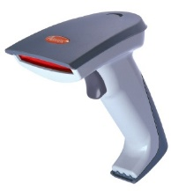
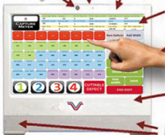
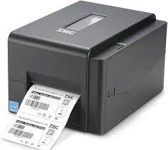
Barcode Scanner
FIDAS SOFTWARE
Length counter
Width Measurement
GSM Scale
Roll Weighing Scale
Barcode Printer

Slide 5
GSM Measurement Counter
Length Measurement Counter
Width Measurement Counter
Roll Weighing Scale
Mini PC with RS-232 Ports
UPS

